Slide 1
Presentation
Harnessing Synergies Between Tuberculosis and Primary Health Care Toward Universal Health Coverage

Slide 2
Outline
Why PHC matters for UHC and TB
05
Call to action
01
Introduction
01
Definition of terms
02
Synergies between PHC and TB response
06
Kenyan situation
02
Global commitments (Alma-Ata, Astana, UNHLM)
03
Integration of health services
07
Conclusion
03
PHC approach and core components
04
Enablers and barriers to the synergistic actions for the PHC approach
08

Slide 3



Introduction
Tuberculosis (TB) remains a major global health challenge-
Leading cause of death from an infectious disease with over 10 million cases and 1.25 million deaths reported in 2023 alone.
Despite being preventable and curable, TB continues to disproportionately affect populations in low- and middle-income countries, particularly those facing poverty, poor living conditions, and limited access to healthcare.
Social determinants worsen TB’s spread and impact
Poverty, food insecurity and malnutrition, overcrowding and limited healthcare access.
Highlights the need for a comprehensive, whole-of-society response.

Slide 4


Introduction
WHO’s End TB Strategy
Focuses on integrated, people-centered care, strong policies, and research-driven innovations.
Emphasizes government leadership, civil society empowerment, and human rights.
Progress towards ending TB is slow and the world is off-track to meet key targets.
This requires intensified global action to address the significant gaps in TB efforts
These gaps include;
Inadequate funding
fragmented financing, especially in LMICs.

Slide 5
Introduction
Aligning TB responses with PHC principles creates strategic opportunities to:
Improve early detection and treatment
Strengthen community-based care and follow-up
Enhance data systems for better surveillance and decision-making
Reduce fragmentation and improve efficiency across health programs
Build stronger, more resilient health systems capable of addressing multiple health challenges simultaneously.

Slide 6
Introduction
Primary Health Care (PHC) approach is crucial since it integrates TB services into broader health systems for efficiency, ensures accessible, affordable, and person-centered TB care, and addresses other health needs alongside TB.
There is urgent need to prioritize PHC to end the global TB epidemic

Slide 7
Definition of terms
2
Primary care
Primary health care (PHC)
01
02
A key process in the health system that supports first-contact, accessible, continued, comprehensive and coordinated patient-focused care.
A whole-of-society approach to health that aims to maximize the level and distribution of health and well-being through three components: primary care and essential public health functions as the core of integrated health services; multi-sectoral policy and action; and empowered people and communities.
PHC-oriented health system
03
Universal health coverage (UHC)
A system organized to ensure the highest attainable health level, maximizing equity and solidarity. Comprises a core set of structural and functional elements that support UHC and equitable access to acceptable services.
04
Ensured access for all people to needed promotive, preventive, resuscitative, curative, rehabilitative and palliative health services that are of sufficient quality to be effective and that do not expose any users to financial hardship

Slide 8
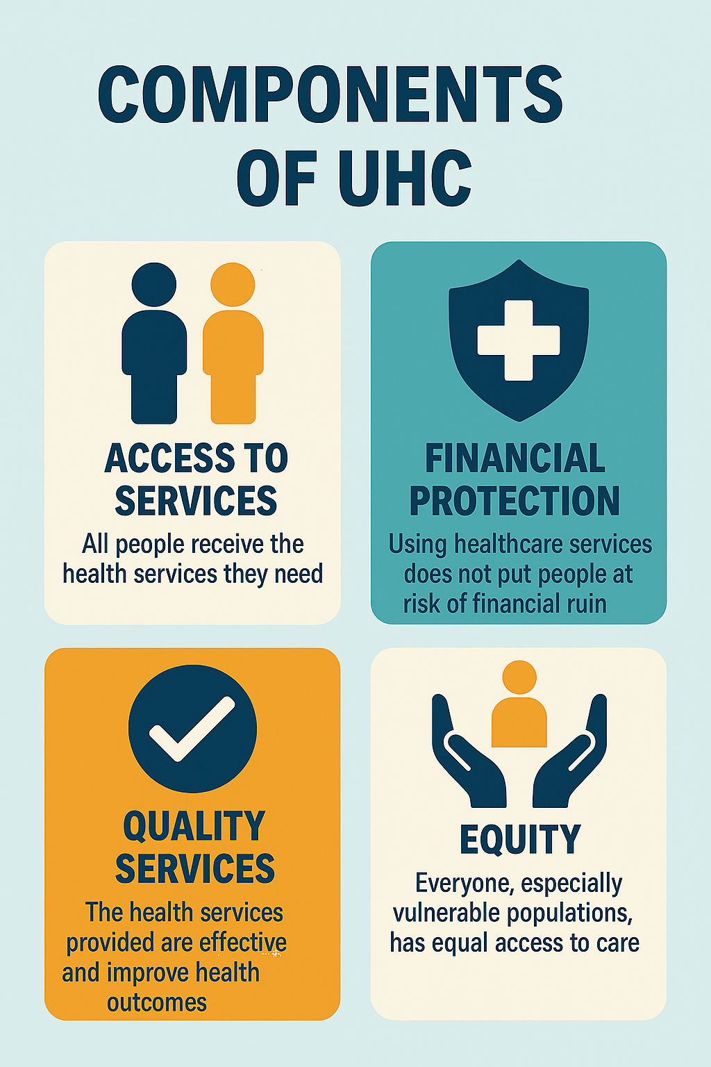
Components of UHC

Slide 9
Global Commitments for PHC
This declaration focuses on four commitments:
making bold health choices across all sectors;
creating sustainable PHC suited to local contexts;
empowering individuals and communities; and
aligning stakeholder support with national policies.
1978 Declaration of Alma-Ata emphasized the importance of PHC for better health outcomes.
2018 Declaration of Astana saw countries commit to aligning health systems with PHC to enhance progress on UHC and health-related SDGs.
In 2022, the 75th World Health Assembly urged a reorientation of health systems towards
PHC as the basis for UHC, reaffirmed by the 2023 UNHLM political declaration on UHC.

Slide 10
PHC Approach and Core Components
The PHC approach is a whole-of-society approach to health that aims to enhance health and well-being through three components:
integrated health services with an emphasis on primary care and essential public health functions;
multi-sectoral policy and action;
and empowered communities.
Notes:
The approach addresses broader health determinants by engaging stakeholders inside and outside the health sector and empowering individuals and communities in their health.

Slide 11
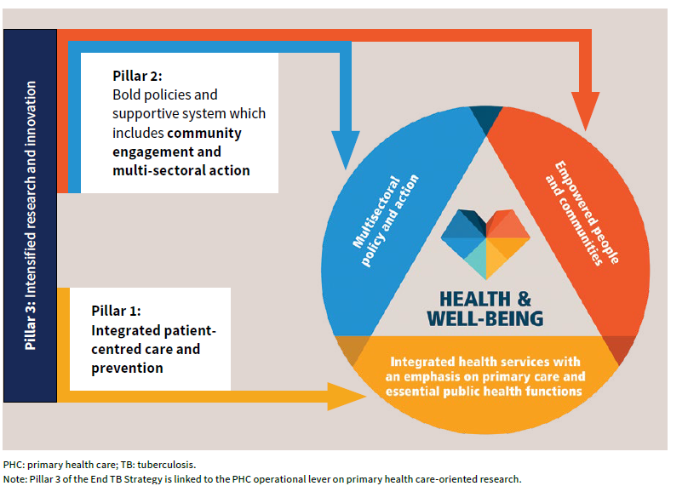
Alignment of the End TB Strategy with the components of PHC

Slide 12

Why PHC matters for UHC and TB
01
Through the 3 components, the PHC approach promotes patient-focused care that is accessible, continuous, comprehensive, and coordinated to optimize population health and reduce health service disparities.
02
It addresses broader health determinants by engaging stakeholders and empowering individuals, families, and communities.
03
Strengthening PHC ensures that TB care is accessible, affordable and people-centred, while addressing other health needs at the same time.

Slide 13
Why PHC matters for UHC and TB
04
PHC-oriented health systems lead to consistently better health outcomes, enhanced equity, and improved efficiency.
05
To end the global TB epidemic, global commitments must therefore urgently be translated into action through sustainable system-wide approaches that prioritize PHC
06
PHC is the foundation for Universal Health Coverage (UHC)
.

Slide 14
Key TB Services at PHC Level
Screening
Case Detection and Diagnosis
TB Preventive Therapy
Treatment and Support
Integrated Care for Comorbidities
WHO emphasizes Public Private (PPM) for TB Care at PHC level facilities

Slide 15
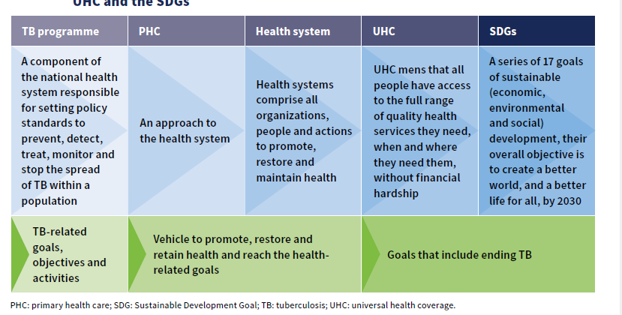
Relationship between the TB Program, PHC, Health System, UHC and SDGs

Slide 16
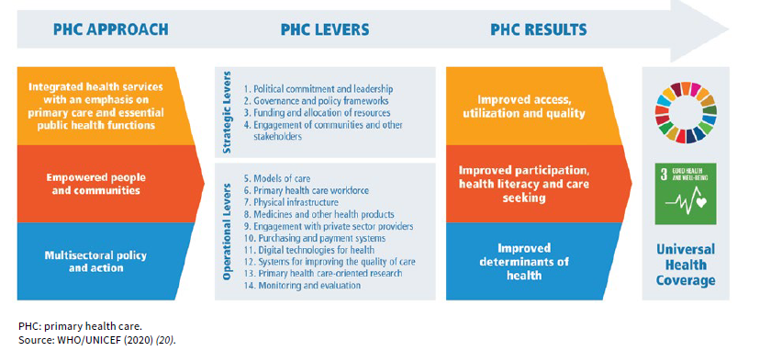
PHC Theory of Change

Slide 17
Integration of Health Services
Integrated health services refer to services that are managed and delivered to provide a continuum of care for:
Health promotion, disease prevention, diagnosis and treatment, disease management, Rehabilitation and palliative care;
and Coordinated across all levels and sites of care, based on people’s needs throughout life.
Benefits of Integrated, People-Centered Care:
Improved access to care, better health outcomes, enhanced health literacy and self-care, increased satisfaction for patients and health workers
Greater efficiency, reduced duplication, and lower overall costs

Slide 18
Integration of Health Services
Purpose of Integration:
Enhance efficiency
Avoid duplication of services
Maximize synergies
Manage diseases with shared risk factors
Link to End TB Strategy (Pillar 1):
Universal access to integrated, patient-centered TB care and prevention
Includes management of TB and associated conditions (HIV, diabetes, mental ill-health tobacco use, alcohol disorders)-ensure comprehensive management of comorbidities.
Improves TB treatment outcomes and strengthens public health overall

Slide 19
Synergies between PHC and TB response
Shared Infrastructure Advantages
Shared data systems and tools
01
02
Utilizing shared health facilities and supply chains enhances service delivery efficiency and comprehensive care.
Primary health care platforms support TB screening, diagnosis, and treatment to reduce service duplication.
Workforce Optimization
03
Community Engagement
Training PHC providers in TB management improves early detection and ensures continuity of patient care.
Use of CHPs for TB contact tracing and patient education
04
Community networks empower local actors to raise TB awareness and support treatment adherence effective

Slide 20
Enablers of synergistic actions for the PHC approach and ending TB
Political commitment
Enables development of necessary policies and resource allocation for TB services.
Collaboration across sectors like health, education, social services, and housing
Integration of TB Services into PHC Frameworks
Embedding TB care within PHC ensures equitable, accessible, and people-centered services.
Strengthens health infrastructure, including laboratory systems and airborne infection control
Multi-sectoral Collaboration
Ending TB requires coordinated action across health, finance, labor, and social services.
Joint planning across sectors helps address social and economic determinants of TB

Slide 21
Enablers of synergistic actions for the PHC approach and ending TB
Community and Civil Society Engagement
Empowering communities enhances awareness, early detection, and treatment adherence.
Civil society plays a vital role in advocacy, accountability, and service delivery
Health Workforce Strengthening
Upskilling health workers to deliver integrated care.
Workforce reallocation ensures coverage across all levels of care
Digital Health and Surveillance Systems
Integrated strategies need robust data platforms for monitoring, evaluation, and decision-making.
Digital tools support case tracking, treatment adherence, and community outreach

Slide 22
Barriers of synergistic actions for the PHC approach and ending TB
01
Inadequate Political Commitment
Insufficient commitment slows progress in strengthening PHC and ending TB.
02
Overstretched Primary Care Facilities
Primary care centres are already strained, and adding TB services may further burden limited resources, including staff and funding. Additionally, stigma surrounding TB can deter individuals from seeking care.
03
Health System Inadequacies
Inadequacies include insufficient health workforce, infrastructure, data management, surveillance systems, fragmented funding, and donor dependency.
.

Slide 23
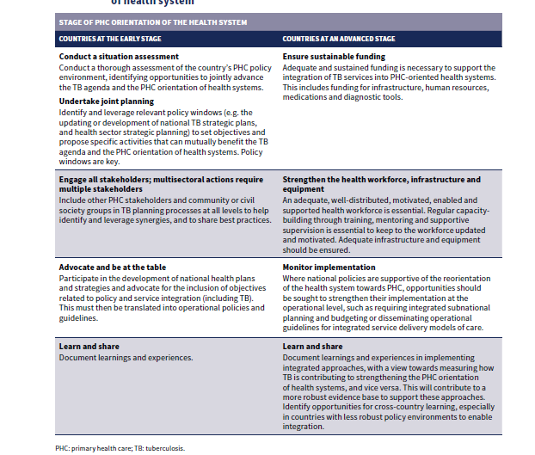
Call to Action
Notes:
The actions that TB program managers, ministry of health officials and other PHC leaders can or should take will depend on what stage their health system has reached in the journey towards PHC
Early stages- lack of political commitment and supportive policies. In such cases, the TB response can play a key role in strengthening the broader health system, encouraging integration at the point of service delivery, multi-sectoral action and community empowerment. Policy reforms may be necessary to enable integrated models of care.
Advanced stage-have political commitment and robust governance structures, alongside policies that promote the PHC approach. These countries should focus on effectively implementing policies that further solidify the PHC orientation of their health systems including enhancement of TB care and prevention.

Slide 24
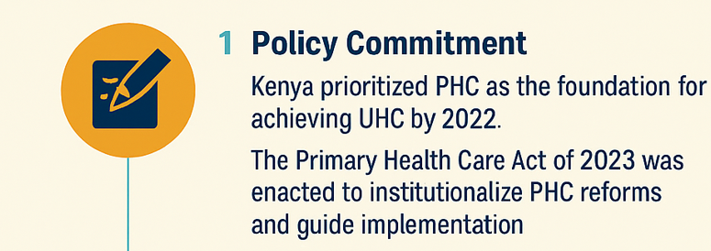
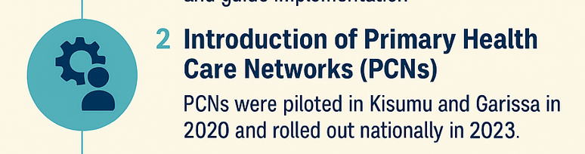
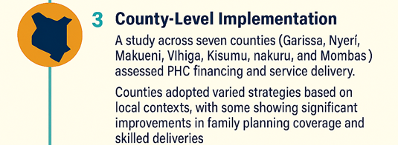


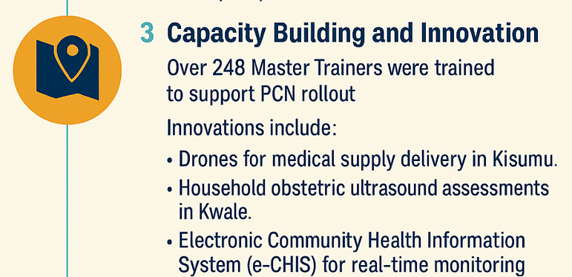
Kenya’s PHC Implementation Journey
Notes:
Kenya’s Primary Health Care (PHC) implementation journey has been marked by strategic reforms, innovative models, and multisectoral collaboration aimed at achieving Universal Health Coverage (UHC).

Slide 25
Primary Care Network (PCN)
Definition
A PCN is an administrative health region established to efficiently improve access to coordinated primary health care(PHC) services.
Coordination and Governance of PHC
Multi-Disciplinary Team
A team of health professionals, working together to provide comprehensive and continuous person-centred PHC services for individuals, families and communities.
Primary Care Network committee (PCNC)
SCHMT
Private
FBO
Partners
Community Rep
MDT rep
Structure
The PCNs are designed to have a modified ‘hub and spoke’ model. The hub is a L4PHC Referral facility and supports the PHC facilities (the spokes) and community health units (CHUs).

Slide 26
Kenya PHC for TB Situation
TB Cases Diagnosed vs CHP Contribution and Performance, Jan 2023 - Jun 2025

Slide 27
Kenya PHC for TB Situation
Number of TB Cases Diagnosed by KEPH Level, Jan 2023 - Jun 2025

Slide 28
Kenya PHC for TB Situation
Proportion of TB Cases Diagnosed by KEPH Level, Jan 2023 - Jun 2025

Slide 29
Contribution of the Community in Active Case Finding and Treatment Follow up
NSP: Increase community TB case finding and notification from 11% in 2022 to 30% by 2028
End of June 2025 community contribution (CHPs, Contact Invitation and Outreaches at 18%
Community Mobilization and Awareness
Household/ Community Led Screening and referral
Contact Tracing and Referral
Stigma Reduction
Treatment Support Networks
Sputum collection and Transportation
Treatment adherence support
TPT follow up
Treatment Interrupters follow up
Counties support Community Health Actors to do household sputum collection and transportation

Slide 30
Utilization of Digital Systems (eCHIS) TB Screening
Benefits of eCHIS
TB symptoms screening questions
Generates referrals to facilities and tracks completion of symptomatic households
Real time data reporting that can improve surveillance, early identification of hotspots and support decision making at sub county and count levels
eCHIS Challenges
Poor understanding of the TB indicators
Limits CHPs to households
System downtimes
Network challenges
Faulty phones

Slide 31
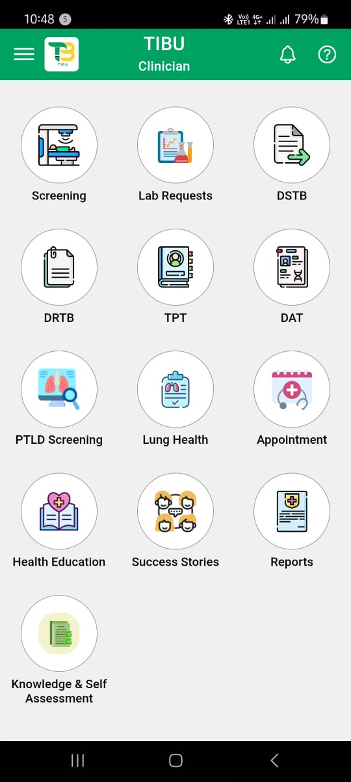
TIBULite-POC PMS
Nakuru County: Tibulite was piloted in 20 sites supported by Amref
Nakuru county: 38 sites supported by CHS through Tamatisha TB
Kirinyaga county: 55 sites supported by CHS through Tamatisha TB

Slide 32
Conclusion
To achieve health-related SDGs, including ending TB, and sustain these gains amid complex demands on health systems, optimizing resources is essential.
Scaling up high-quality, people-centred services through a PHC approach is crucial for meeting both disease-specific and broader health goals.
All populations must access health services and benefit from resources free from stigma and discrimination.
Conducting an analysis of the policy environment at the country level is a crucial first step towards identifying entry points to develop a pathway for aligning the TB response with the PHC approach.
A sustainable system that ensures a PHC approach to TB will require continued advocacy and adaptation.
Coordinated planning for system development will address multiple health issues at the same time, while also helping to achieve the targets for specific diseases, like for TB.

